Slide 1
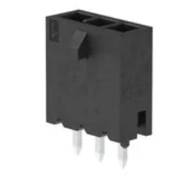
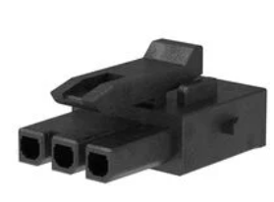
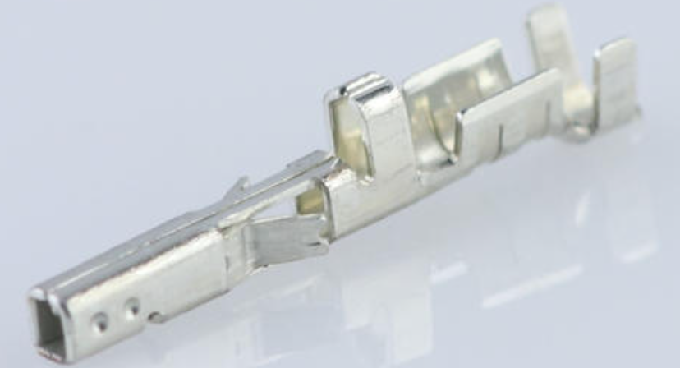
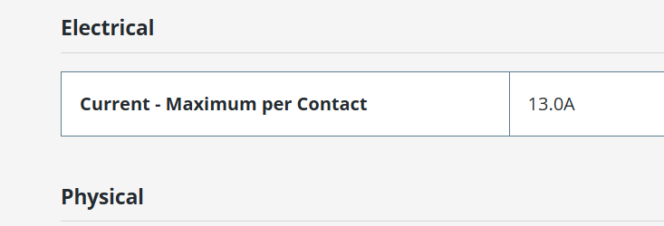
1) Battery input and DCDC converter schematics
a. Suggest 12V DCDC converter output current limit to be reduced to 14A. Mode 2 resistor to change to 200K.
b. 12V DCDC converter 22uF low ESR capacitors to be increased from 11 to 12.
c. Board output connector (TE 640388-3) mating header (TE 2132189-3) crimps are only rated at 6.5A. Any alternatives? Or should we use solder pads on this board, with a higher rated on the connector expansion board?
→ 1a: I will adjust it
1b: I will add it
1c: Yes, you're right. I didn't check the crimps. I've found a more suitable option from Molex:
Header: 2165711003
Housing:2157591003
Crimp: 2064600041

Slide 2
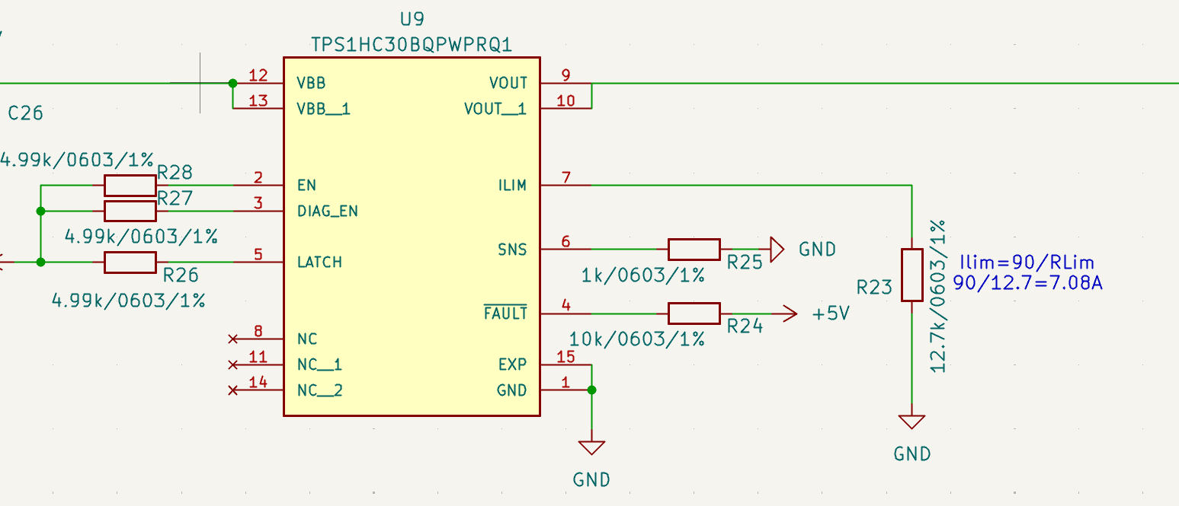
2) Output connector board and e-Fuse schematic
Winch output uses TPS1HC30BQPWPRQ1. IC is rated at 5A with a continuous output of 4.5A, and maximum current limit of 12A. Nominal operating current is feasible to be 5A.
i. Efuse on Winch appears to be trickier than anticipated. Suggest we revert to no e-fuse and current limit to 14amp on 12v dcdc IC on power management
→ 2.a.i: In my opinion, we should not rely on the DC-DC block to provide over-current protection for the winch. For the TPS1HC30BQPWPRQ1, I have already configured the current limit to 7A, so the winch output is protected at the load switch level.

Slide 3
2) Output connector board and e-Fuse schematic
b. Overvoltage protection (OVP) is implemented all outputs except the Reel output. As the main DCDC converters have overvoltage protection, the requirement for additional overvoltage protection may not be required. 12V DCDC converter will shut down if output voltage exceeds 14.5V, which is close to 14.04V selected on output board. The 5V DCDC converter shuts down at 6V output, thus the 7.04V protection on the output board will never operate.
i. Should we just have 1 set of divider resistors for 12v and 5v each. Then feed signal to all 5v efuses and 12v efuses. Don’t think you we can leave overvoltage pins unconnected, may need to double check datasheets.
→ 2.b: I understand. However, it seems I will switch to a different IC, TI’s TPS259571DSGR.

Slide 4
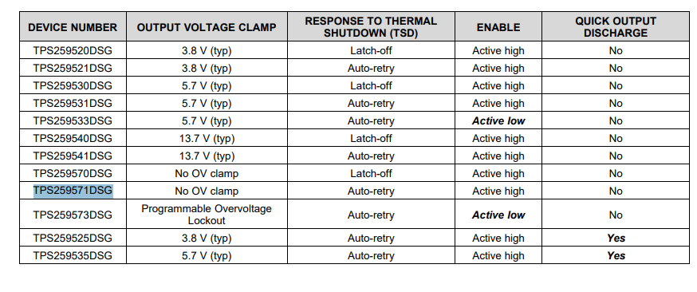
2) Output connector board and e-Fuse schematic
c. SIP32433ADN-T1E4 used is of latching type. If operated, power must be removed and restored to reset output, not ideal behaviour
→ 2.c: The auto-retry version of the SIP32433ADN-T1E4 IC is almost out of stock across most distributors. I think I will switch to TI’s eFuse TPS259571DSGR instead.
It meets the required specifications, and I do not plan to use its UVLO feature.

Slide 5
2) Output connector board and e-Fuse schematic
d. Spare output appears misspelled as Square1.
→ 2.d: I will fix it.
e. Digikey part number for 12V PCB connectors needs updating to 900-1723103302-ND.
→ 2.e:900-1723103302-ND is out of stock at Digi-Key.
I think using 900-1723103102-ND should be fine. The difference is that 900-1723103302-ND has 0.78 µm gold (Au) plating.
f. Board input connector (TE 640388-3) mating header (TE 2132189-3) crimps are only rated at 6.5A. Suggest a connector combination with a higher current capacity is used.
i. This should be a right-angled connector, whereas the power management board should be vertical.
1. Refer to 1c. Prefer to have connector on this board as more room
→ 2.f:Please use the connector specified in item 1c.
The right-angled version, part 2157601003, can be used..
g. Schematic mentions use of E92 series 1% resistors. This should be E96 series?
→ 2.g:Yes, that’s correct — it belongs to the E96 series

